Slide 1
Shreyas Cholia & Oliver Ruebel NERSC Data & Analytics Services Group Jupyterhub Day, July 17 2015
Jupyterhub at NERSC and OpenMSI

Slide 2


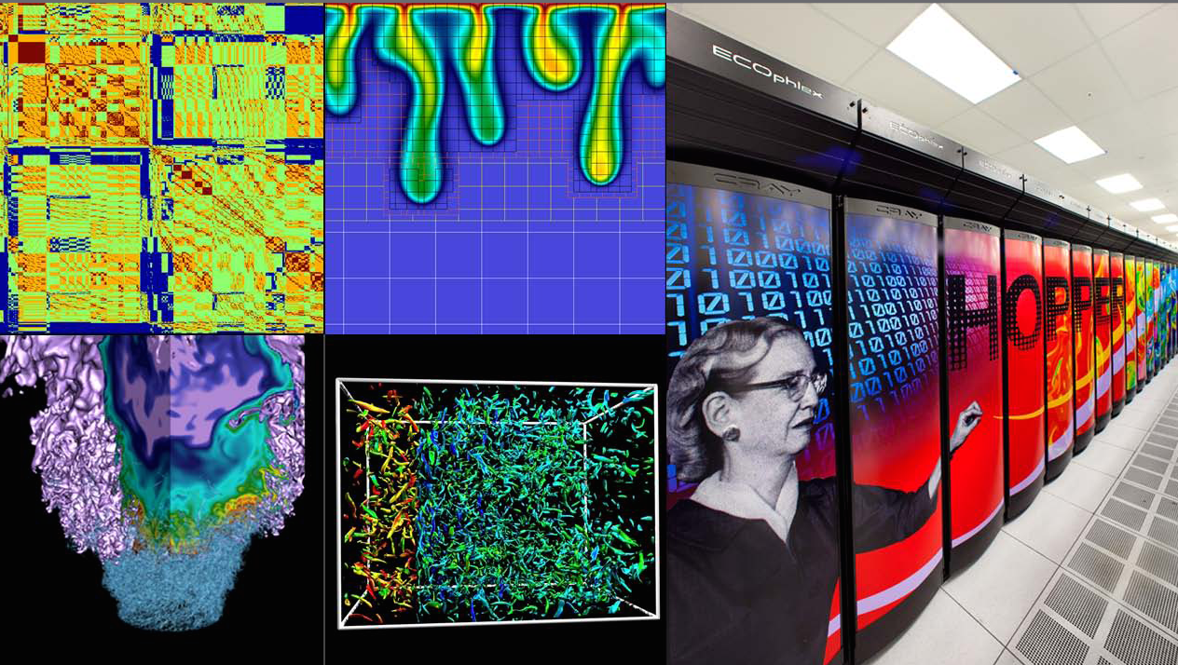



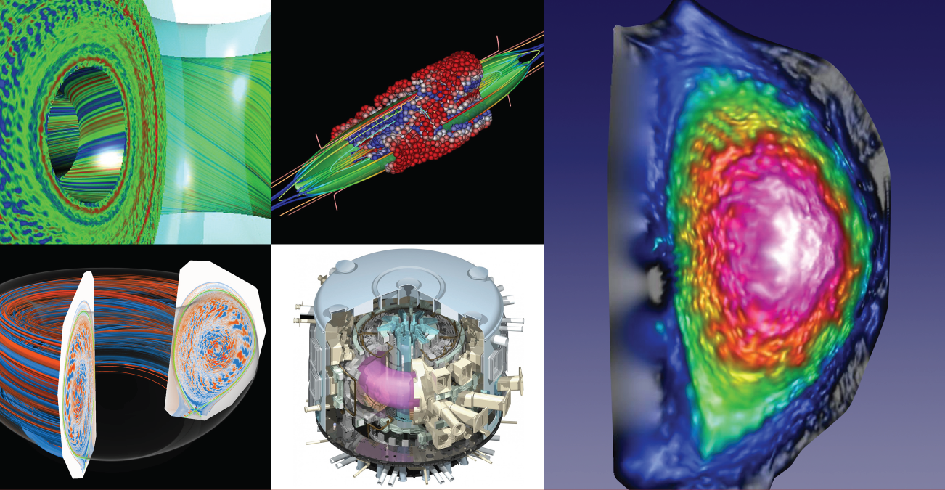
NERSC is the Production HPC & Data Facility for DOE Office of Science Research
Largest funder of physical science research in U.S.
Bio Energy, Environment
Computing
Materials, Chemistry,
Geophysics
Particle Physics, Astrophysics
Nuclear Physics
Fusion Energy,
Plasma Physics

Slide 3
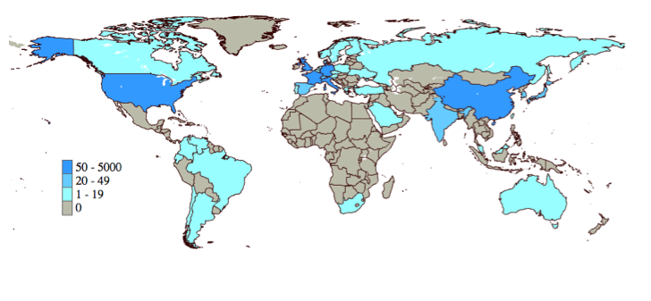
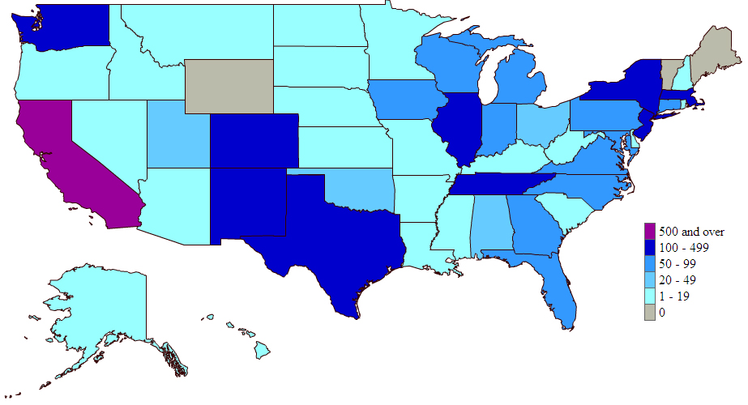
We support a broad user base
5000 users, and we typically add 350 per year
Geographically distributed: 47 states as well as multinational projects

Slide 4
Motivating Use Cases
Python is the most popular language/tool at NERSC for scripting up workflows and analyzing scientific data
Users want to be able to use ipython notebooks to look at the products of their jobs
Access to NERSC resources (Filesystems, Network, DBs) is key
Add their own libraries to the notebook environment in a consistent manner
Individual users to run their own notebook servers presents a potential security hole

Slide 5
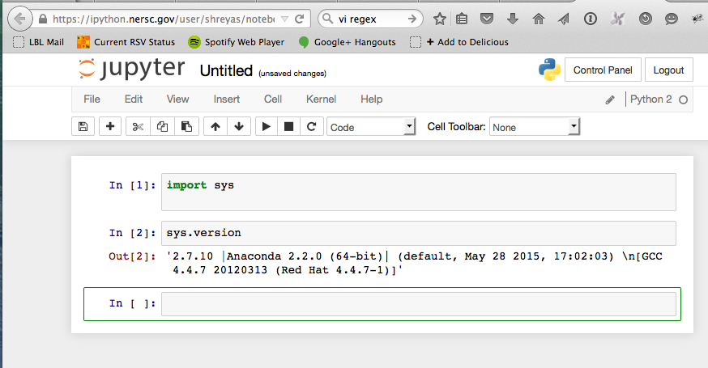
NERSC Jupyterhub
We have deployed a Jupyterhub server with access to NERSC resources
Uses LDAP for authentication
Access to NERSC global filesystems
Runs inside NERSC network

Slide 6
Configuration Details
No code modifications needed – we’ve managed to handle everything via config files
Patch for group perms
Jupyterhub runs in a Docker container to minimize exposure to system resources
Notebooks spawned via local process spawner
Kernels available to user
Python 3
Anaconda Python 2

Slide 7
Wishlist
Easy integration of user libraries – right now it is tricky for users to install their own libraries into the ipython notebook environment.
Can we launch notebook into a custom user venv?
qsub spawner – allow a notebook to be launched as part of a job
Can we spawn docker containers from within a container?
Driving a Spark cluster from a notebook
Integration of ipython cluster with SLURM
Security auditing/logging stuff that goes over the control channel

Slide 8
Early Users
OpenMSI
LUX
Cosmo
CMB
NGBI
Metatals

Slide 9
OpenMSI Use case

Slide 10
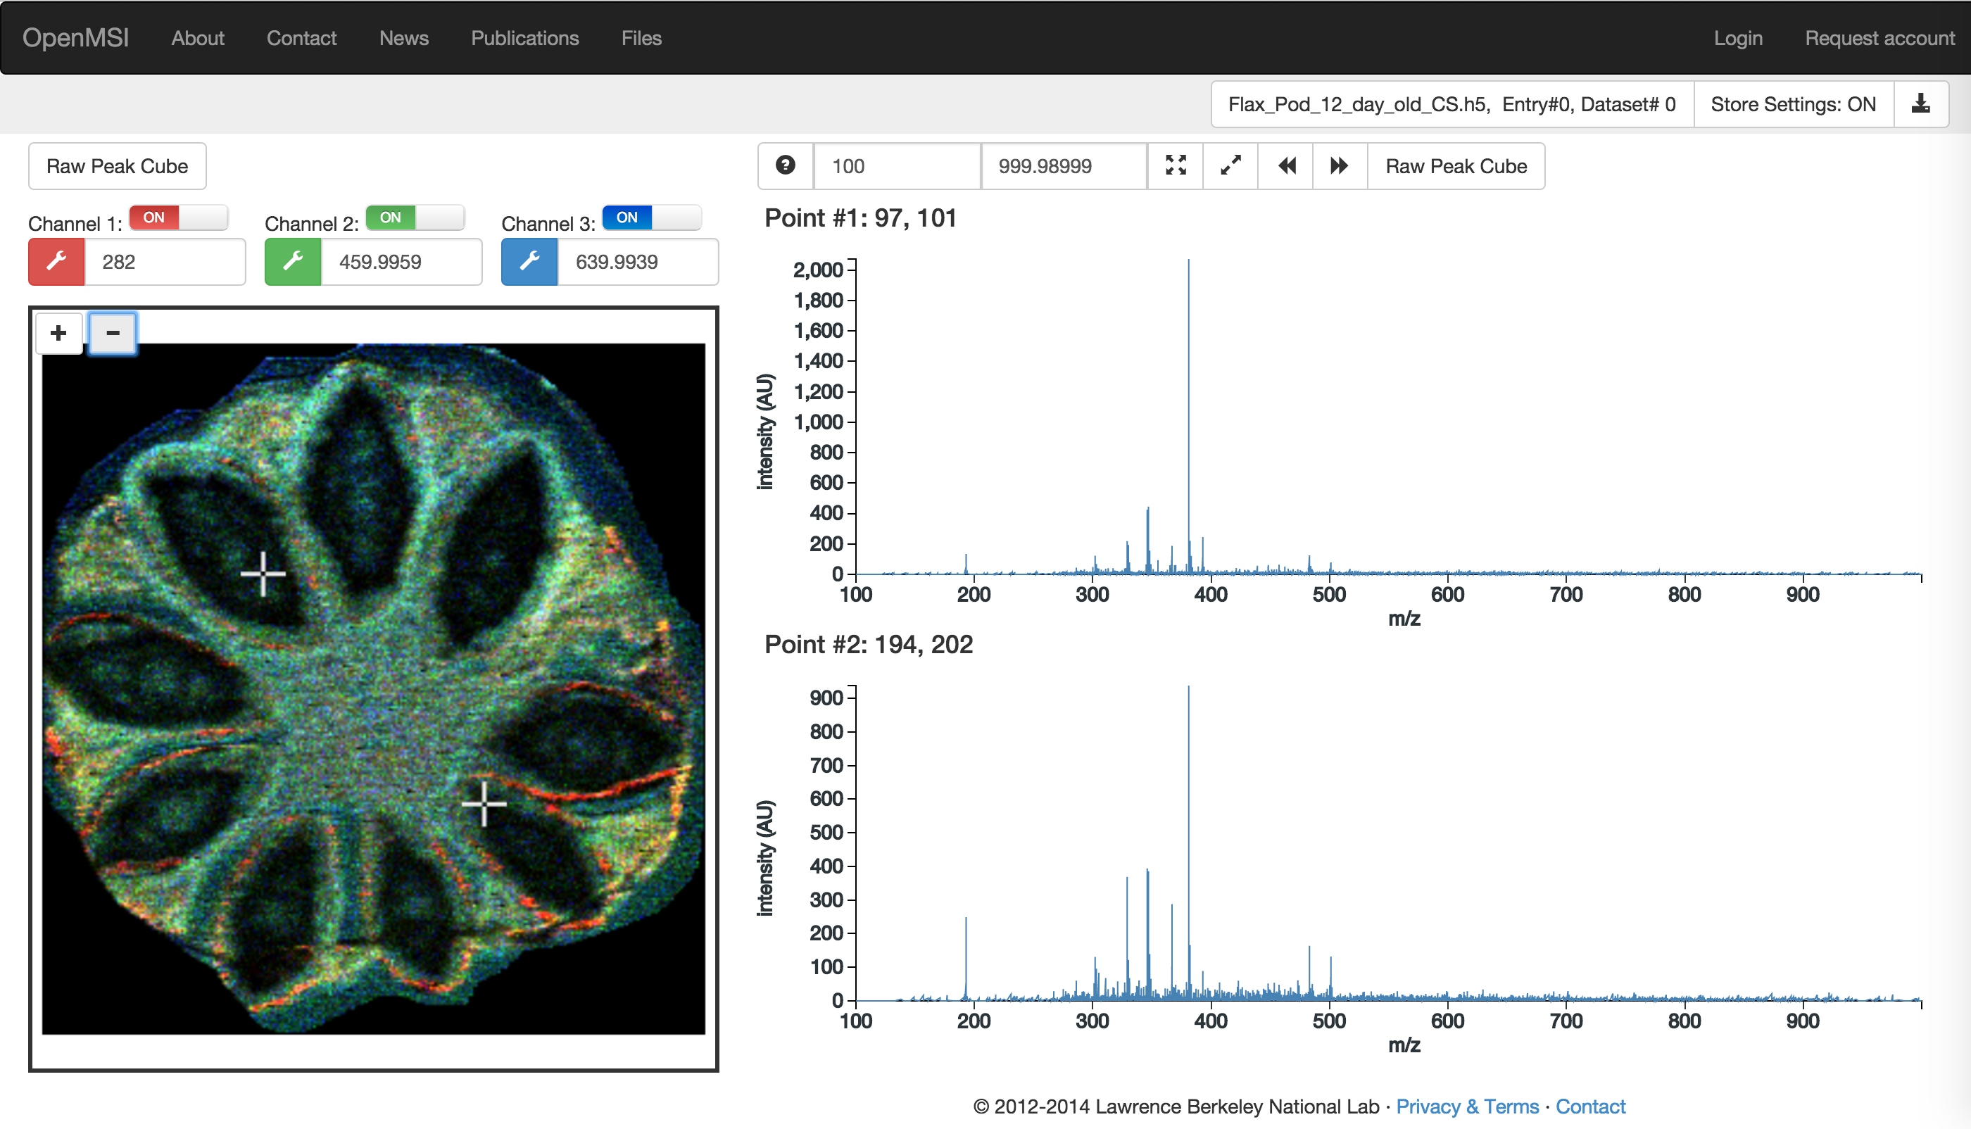
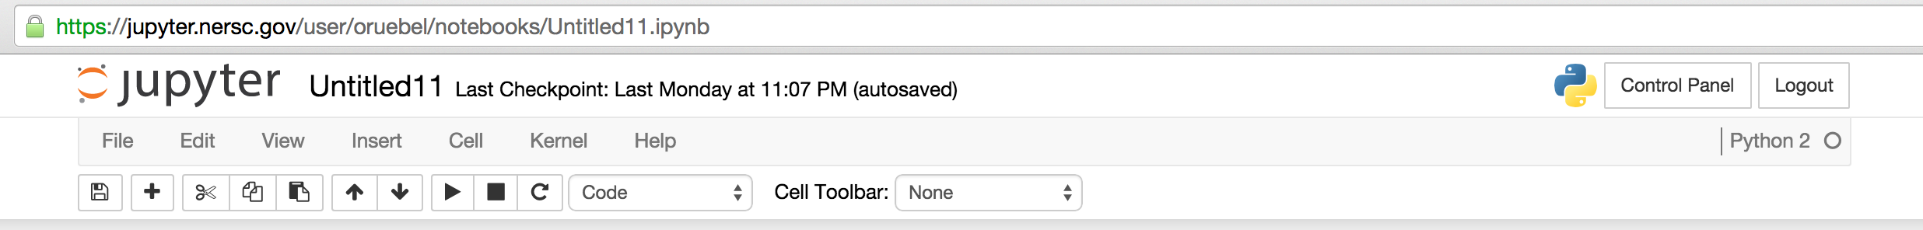
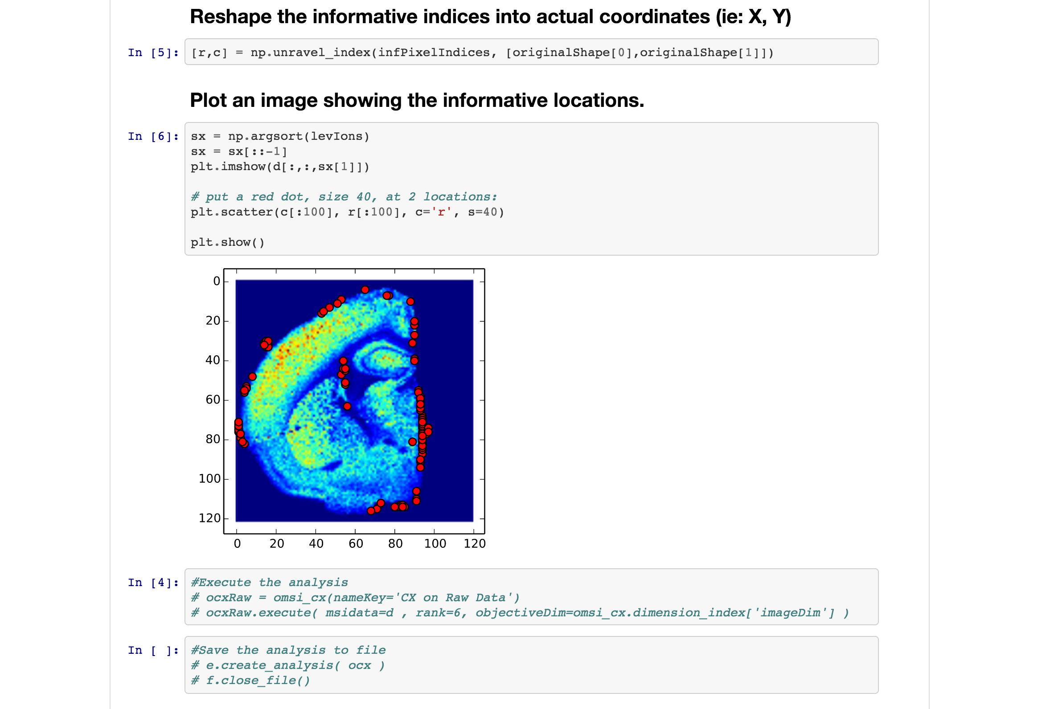
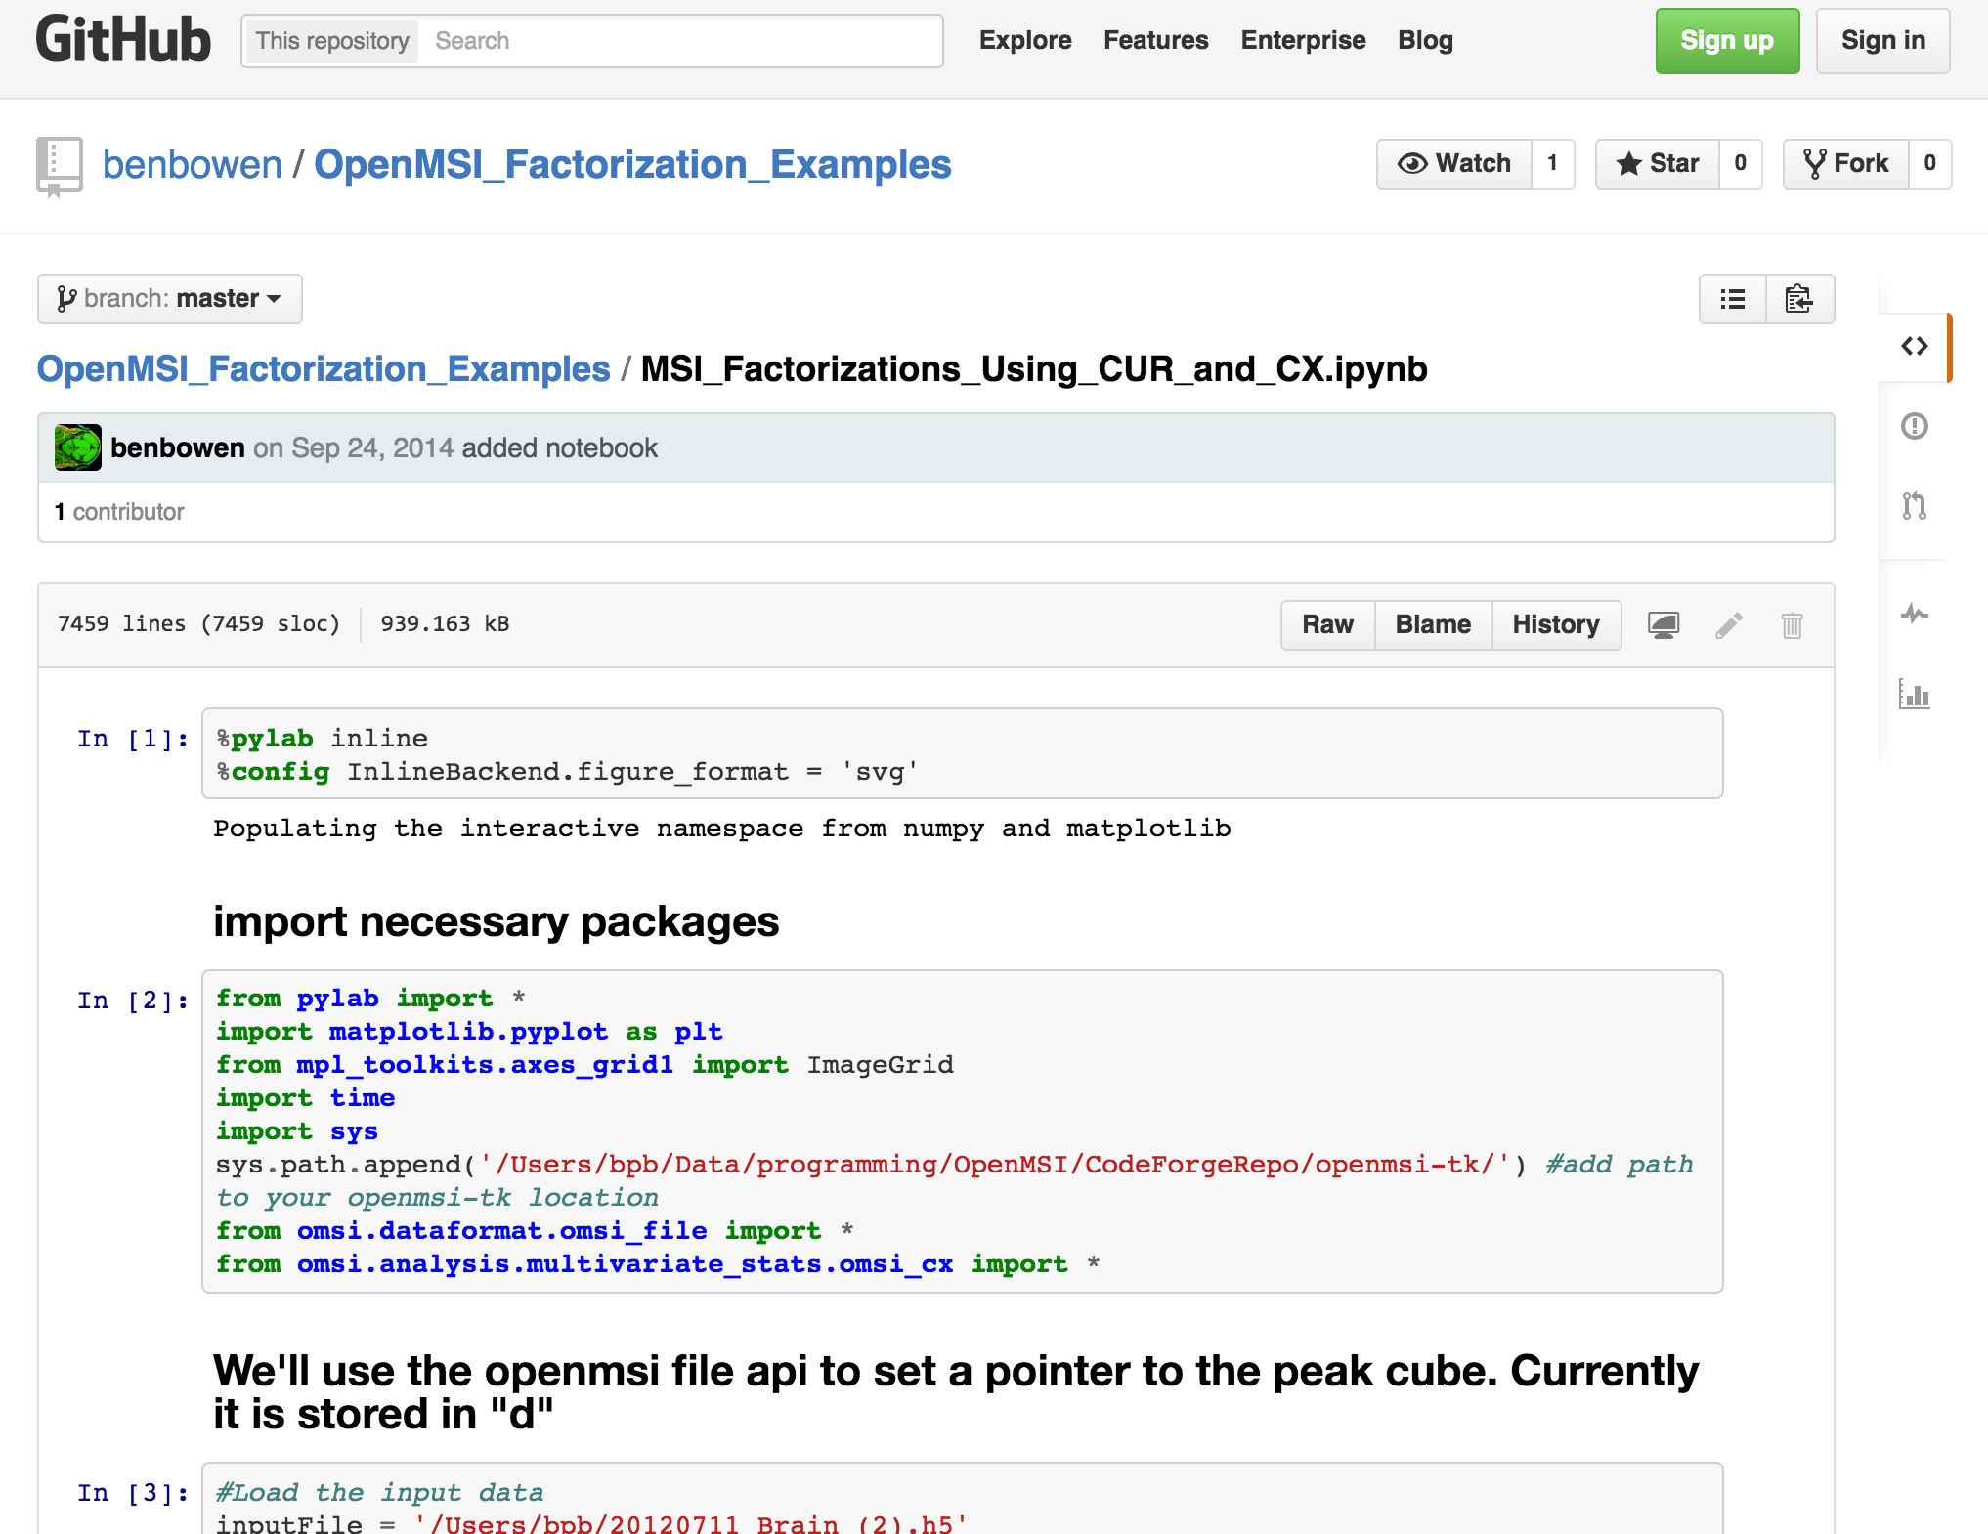
OpenMSI + Jupytherhub
openmsi.nersc.gov
jupyter.nersc.gov
Launch, run, and integrate notebooks
Manage data, analyses, users and resources
Customize templates
Share analysis results
Template analysis notebook repository
User notebook repository
Contribute new analysis templates

Slide 11
OpenMSI + Jupytherhub: A Vision With Long Term Impact
Customizable template notebooks
Programmatic and graphical UI to easily customize notebooks ––e.g., change qualified analysis parameters via query string or UI fields––without requiring users to write code
Ability to customize and integrate external jupyterhub service with science gateway
Ability to save notebooks directly to external repositories (e.g., github), without requiring users to know git
Integration of user-level data access controls with jupyter
Share notebooks …Sharing code and methods between expert programmers and beginners alike

Slide 12
Thanks! Contact: scholia@lbl.gov

